Slide 1
PIP4004: UNIVERSITY PROJECT Review-0 Presentation
Phishing Attack Detection using AI/ML
Batch Number: CSE_CAI_CAP_35
Roll Number | Student Name
Under the Supervision of,
Ms. Kayalvizhi
Assistant Professor
School of Computer Science and Engineering
Presidency University
DINESH KUMAR K | 20211CAI0074
PRAJWAL KANTHAN T | 20211CAI0075
MANJUNATH A C | 20211CAI0124
AKASH S | 20211CAI0110
Name of the Program: B-Tech
Name of the HoD: Dr. Zafar Ali Khan N
Name of the Program Project Coordinator: Dr. Afroz Pasha
Name of the School Project Coordinators: Dr. Sampath A K / Dr. Abdul Khadar A / Mr. Md Ziaur Rahman

Slide 2
Content
Problem Statement
Github Link
Analysis of Problem Statement
Timeline of the Project
References

Slide 3
Problem Statement Number:
Organization: National Technical Research Organisation,(NTRO)
Category (Hardware / Software / Both) : Software
Problem Description: Phishing attacks are a common form of cybercrime where attackers impersonate legitimate entities to deceive users into revealing sensitive information (e.g., login credentials, financial details). This project aims to build an AI/ML-based solution that detects phishing attacks in emails, URLs, or messages.
Difficulty Level: Moderate to High (requires advanced data preprocessing, model training, and real-time deployment)

Slide 4
Github Link
Github Link
https://github.com/Dinesh-Kumar-Tech/CSE_CAI_CAP_39_Phishing-Attack-Detection-using-AI-ML.git

Slide 5
Analysis of Problem Statement
Technology Stack Components:
Programming Languages:
Python
Libraries & Frameworks:
Pandas, NumPy (Data Processing)
Scikit-learn (Machine Learning)
TensorFlow / PyTorch (Deep Learning Models)
Flask / Streamlit (Web App Deployment)
NLTK / spaCy (NLP)
Data Science Tools:
Jupyter Notebooks (for prototyping)
Deployment Tools:
Heroku / AWS / Google Cloud

Slide 6
Analysis of Problem Statement (contd...)
Software and Hardware Requirements:
Software:
Python (3.x)
Scikit-learn, TensorFlow, Pandas, Numpy, Flask, Streamlit
Jupyter Notebook / IDE (VSCode, PyCharm)
Hardware:
Minimum of 8 GB RAM for training models efficiently
GPU (if using deep learning models like LSTM, BERT)
Stable internet connection for cloud deployment and dataset access

Slide 7
Analysis of Problem Statement (contd...)
Impact:
Phishing attacks continue to be a major security threat for individuals and organizations. Detecting them early can prevent financial loss and personal data theft.
Objective:
Build an AI/ML-based solution to identify phishing content with high accuracy using text-based features, NLP, and classification algorithms.

Slide 8
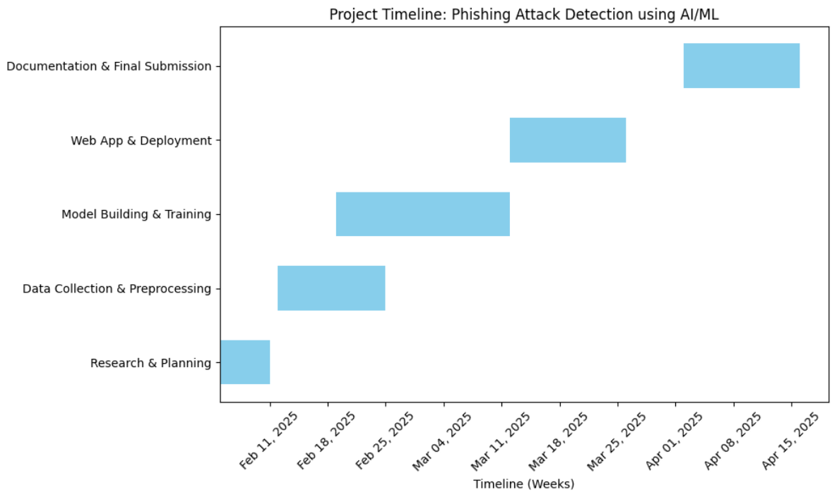
Timeline of the Project (Gantt Chart)

Slide 9
References (IEEE Paper format)
B. Smith, C. Johnson, and D. Lee, "A Survey of Phishing Detection Techniques: Machine Learning and Deep Learning Approaches," IEEE Access, vol. 8, pp. 12234-12247, 2021.
M. K. Sharma, "Machine Learning Models for Phishing Attack Detection," International Journal of Computer Applications, vol. 12, no. 6, pp. 567-579, 2019.
R. Gupta and S. Verma, "Phishing URL Detection Using Natural Language Processing," IEEE Transactions on Information Forensics and Security, vol. 15, no. 3, pp. 509-519, 2022.
J. Singh, P. Patel, and R. Roy, "Phishing Detection with Hybrid Deep Learning Networks," Proceedings of the IEEE Conference on Cybersecurity and Privacy, pp. 203-211, 2021.

Slide 10


